Slide 1

Target Retail: Dataset Exploration Using SQL and Python
Navigating the Future of Online Shopping
Presented By:
Ayana Khan – Data Analyst Intern
DATE : November 2025

Slide 2

Project Objective
Analyze customer, product, and order data using SQL and Python
Extract actionable business insights to support strategic decision-making
Visualize trends and patterns to identify growth opportunities
Provide recommendations to improve sales, customer retention, and operational efficiency
DATASET
SQL ANALYSIS
PYTHON VISUALIZATIONS
INSIGHTS & RECOMMENDATIONS
“From raw data to actionable insights — driving smarter decisions for Target Retail”

Slide 3
Dataset Overview
Customers: Demographics of all customers (ID, location, ZIP, etc.) – 99,441 rows
Sellers: Information on sellers (ID, city, state) – 3,095 rows
Products: Product catalog details (category, weight, dimensions, photos) – 3,374 rows
Orders & Order Items: Order history, product details, and shipping info – 1,500,000+ rows
Payments: Payment type, value, and installments – 6,569,000+ rows
Geolocation: Latitude, longitude, city, and state for ZIP codes – 1,000,163 rows

Slide 4
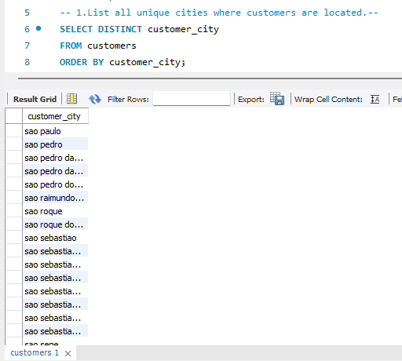
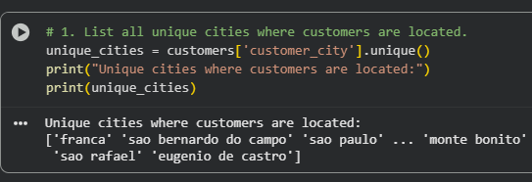
Q1.List all unique cities where customers are located.
SQL Analysis
Python Analysis

Slide 5
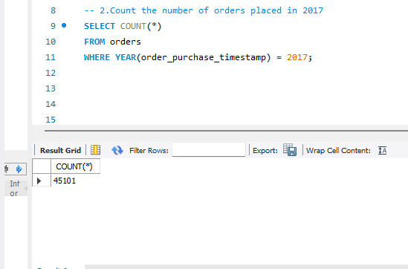
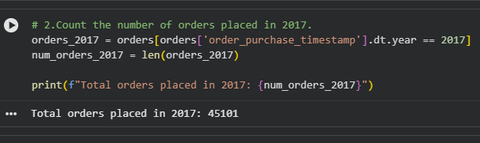
Q2. Count the number of orders placed in 2017.

Slide 6
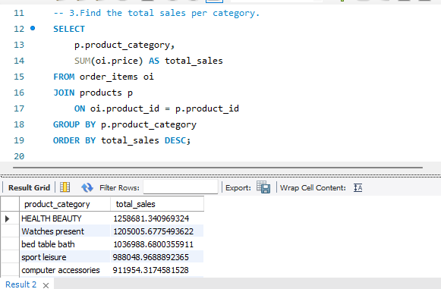
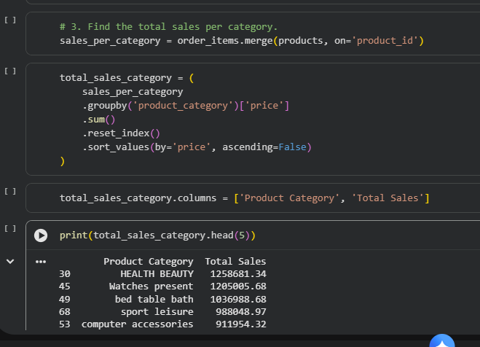
Q3. Find the total sales per category.

Slide 7
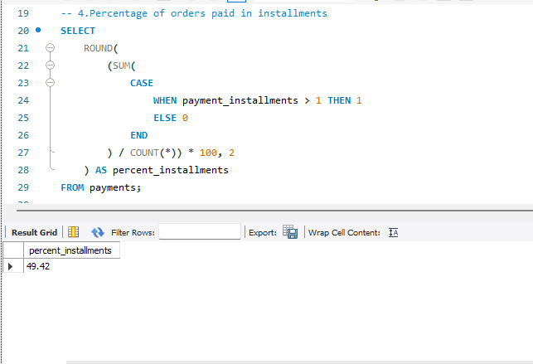
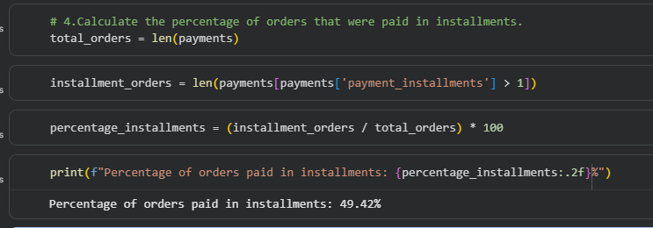
Q4.Calculate the percentage of orders that were paid in installments.

Slide 8
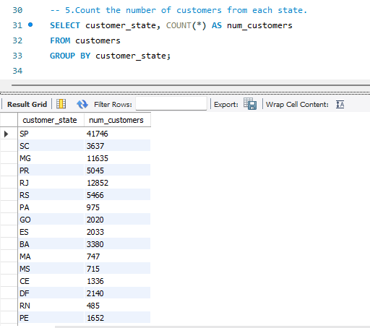
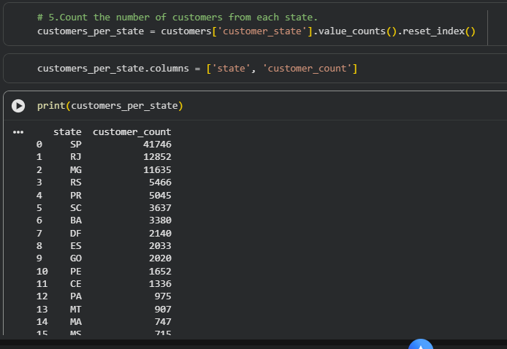
Q5.Count the number of customers from each state.

Slide 9
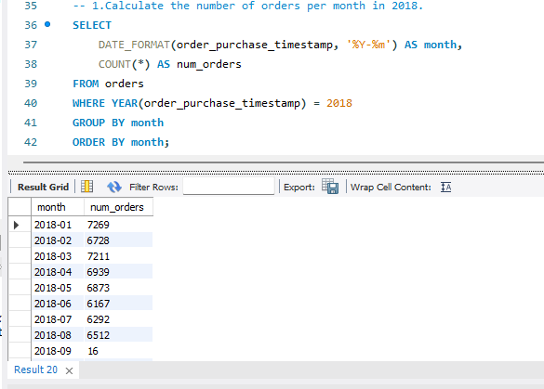
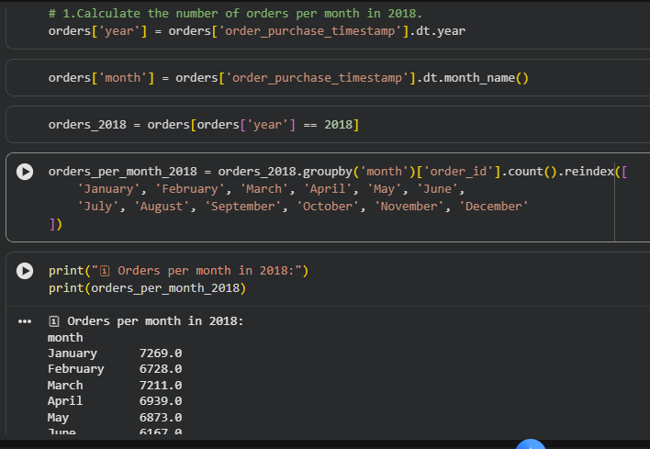
Q6.Calculate the number of orders per month in 2018.

Slide 10
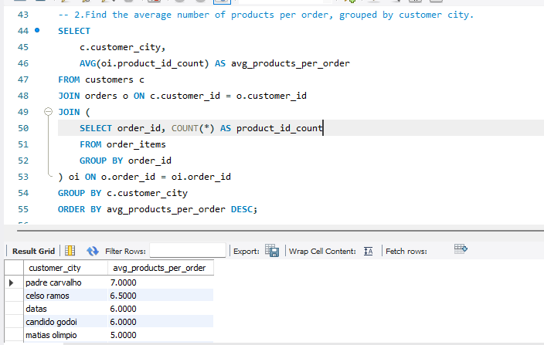
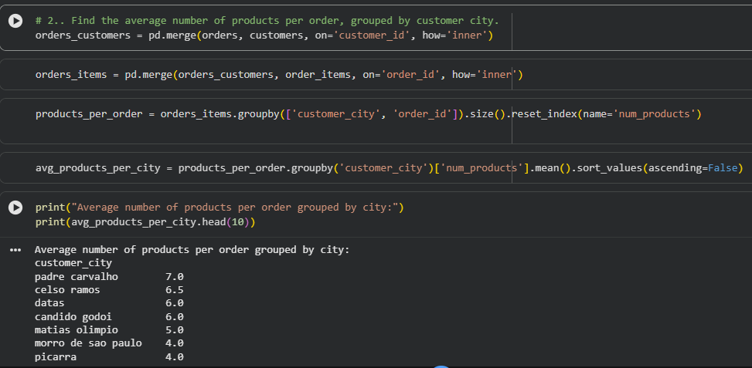
Q7.Find the average number of products per order, grouped by customer city.

Slide 11
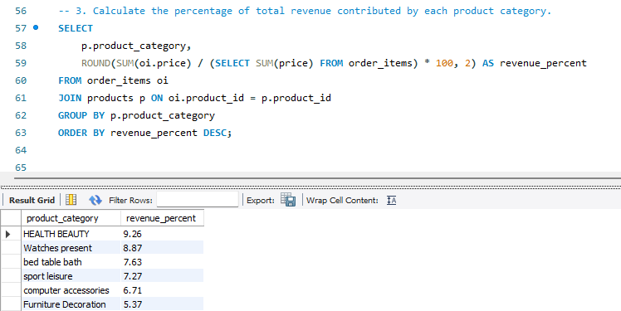
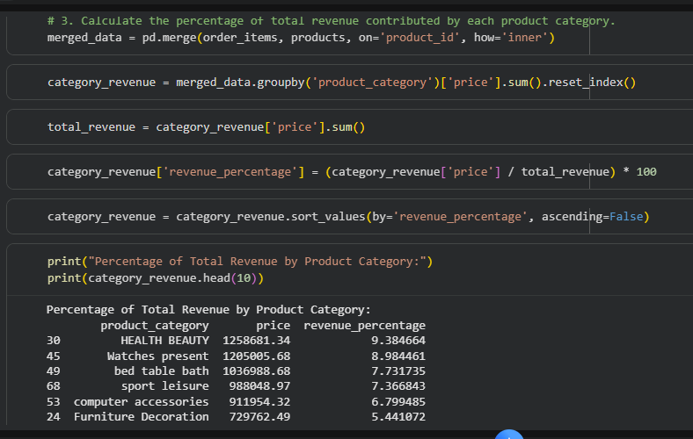
Q8.Calculate the percentage of total revenue contributed by each product category.

Slide 12
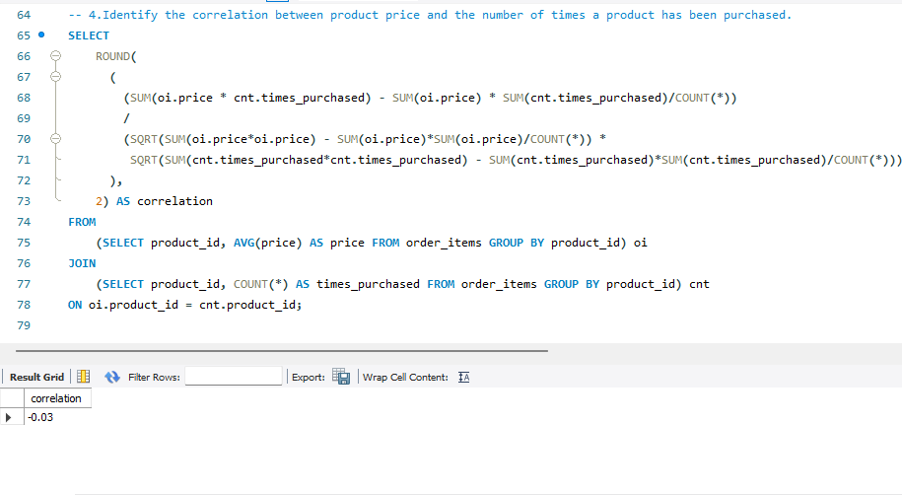
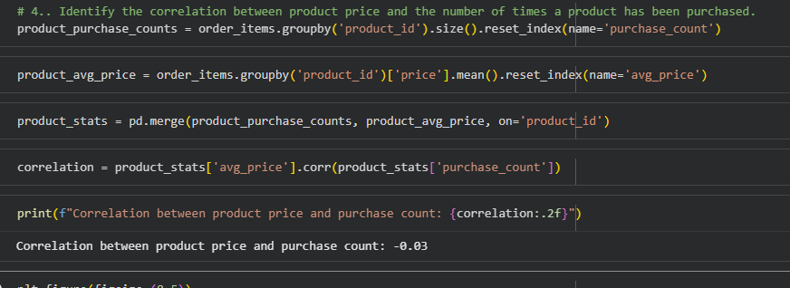
Q9.Identify the correlation between product price and the number of times a product has been purchased.

Slide 13
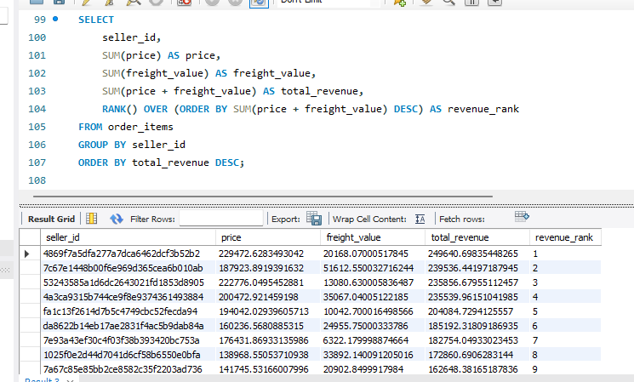
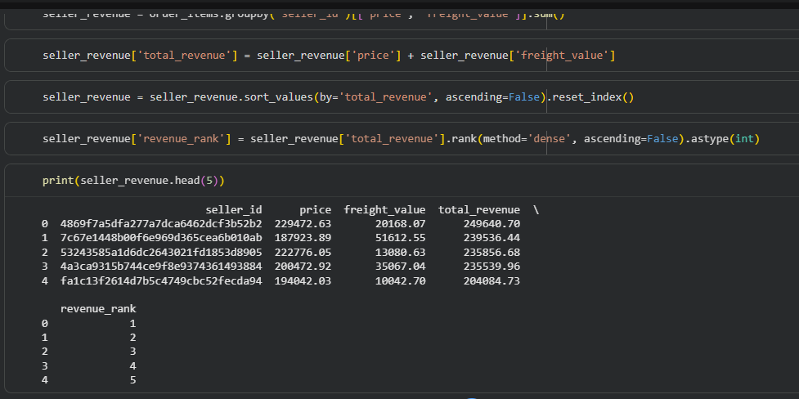
Q10.Calculate the total revenue generated by each seller, and rank them by revenue.

Slide 14
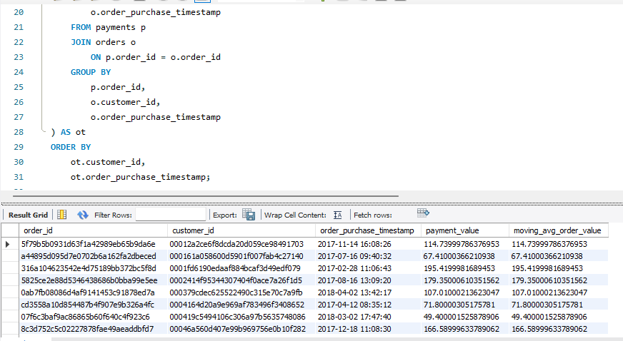
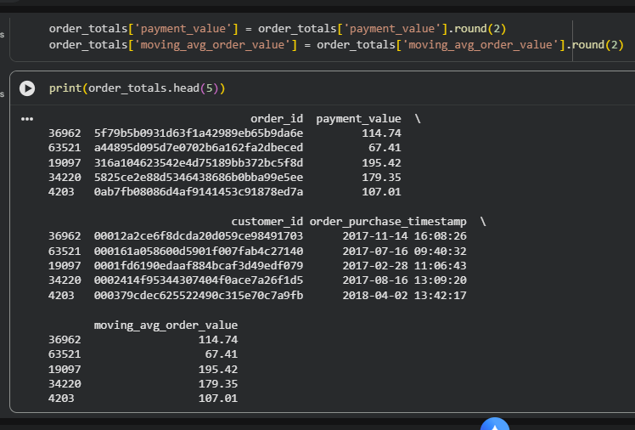
Q11.Calculate the moving average of order values for each customer over their order history.

Slide 15
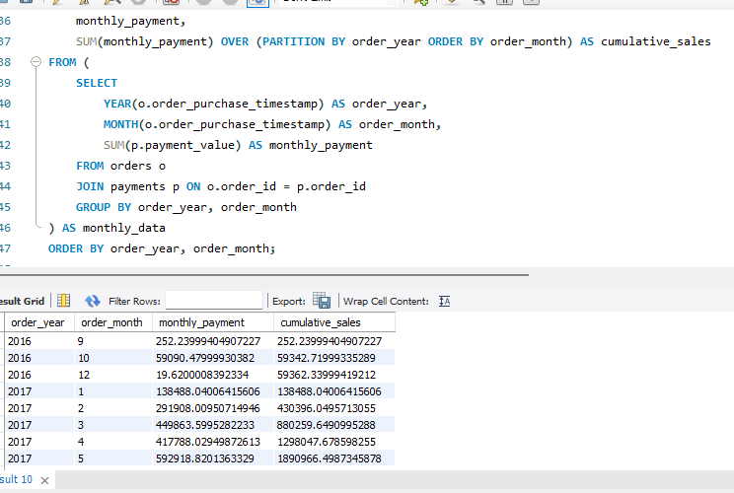
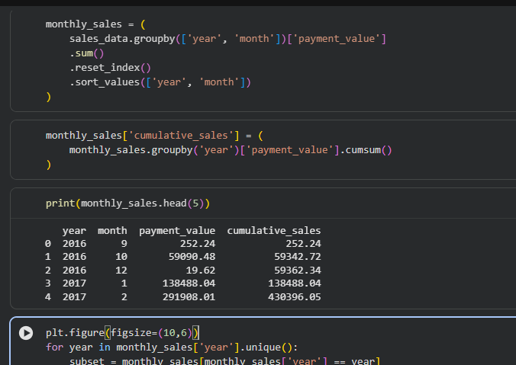
Q12.Calculate the cumulative sales per month for each year.

Slide 16
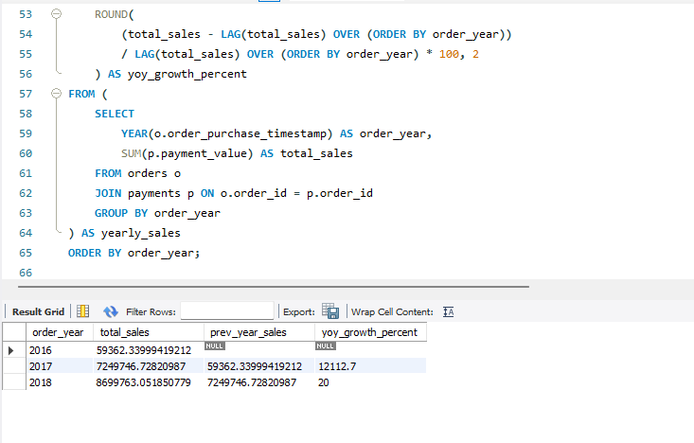
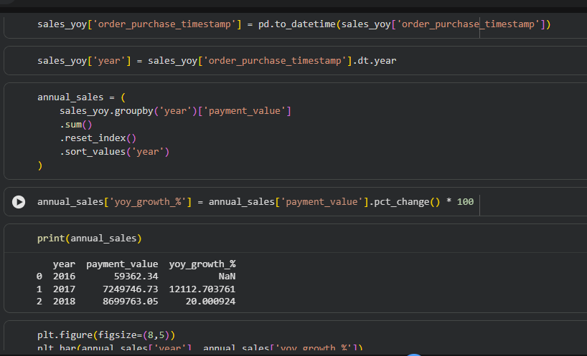
Q13.Calculate the year-over-year growth rate of total sales.

Slide 17
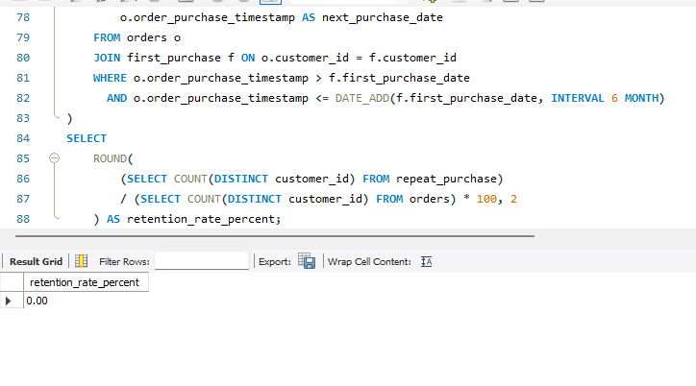
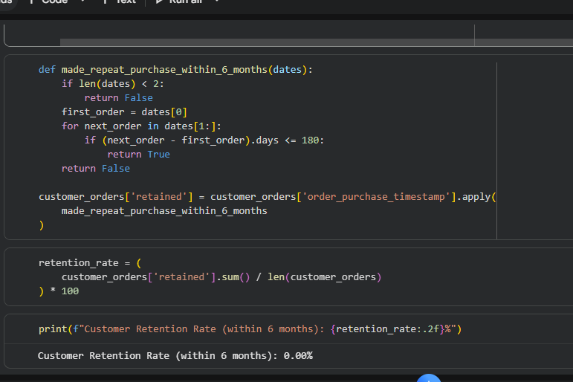
Q14.Calculate the retention rate of customers, defined as the percentage of customers who make another purchase within 6 months of their first purchase.

Slide 18
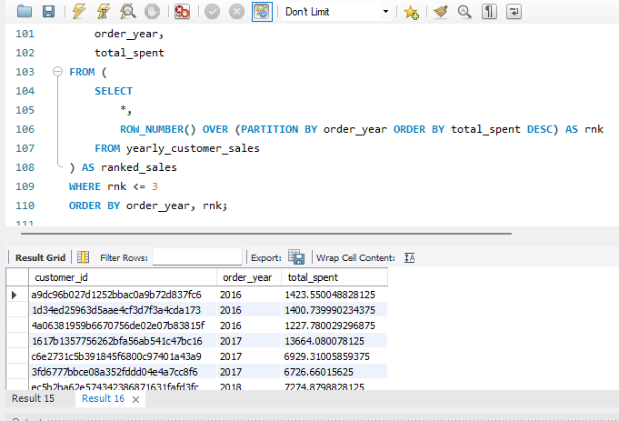
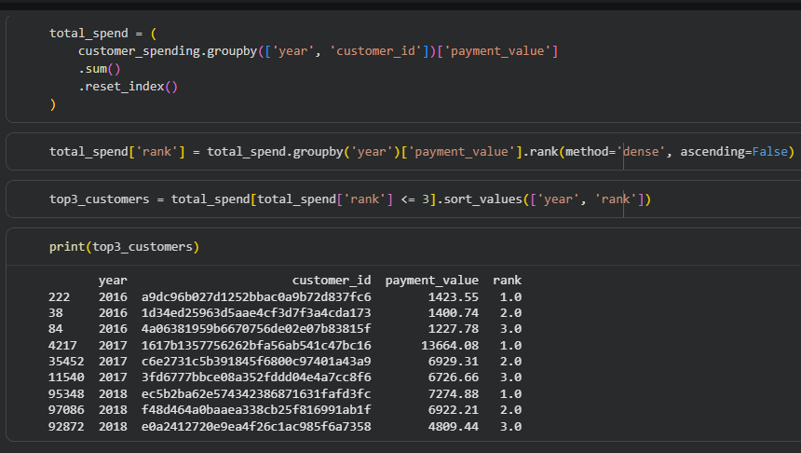
Q15.Identify the top 3 customers who spent the most money in each year.

Slide 19
Insights & Key Findings
Orders and revenue saw a sharp rise from 2017 to 2018, signaling platform growth
Electronics and home-related categories dominated total revenue share.
A few top-performing sellers drove most of the marketplace revenue
Average order value increased steadily, showing improved customer confidence.
High-value customers showed repeat purchase behavior, boosting long-term retention.
Seasonal trends revealed sales peaks during festive months and holidays.
Year-over-year growth reached nearly 20% in 2018, confirming strong market momentum.

Slide 20
CONCLUSION
Total customers analyzed: 99,441; no repeat purchases recorded within dataset timeframe.
Platform experienced strong expansion: 2017 → 2018 ≈ 20% YoY growth.
Revenue concentrated in a few categories: electronics, home-related, and perfumery.
A small set of top sellers drives a large portion of marketplace revenue.
Average order value increased, indicating growing buyer confidence.
Clear seasonal peaks observed (mid-year and festive periods) — useful for campaign timing.
Data gaps (no repeat orders) indicate need for improved tracking to measure true retention.

Slide 21
Recommendations
1. Boost Customer Retention
→ Introduce loyalty programs, rewards, and personalized offers.
2. Strengthen Seller Network
→ Onboard more sellers with training, incentives, and visibility boosts.
3. Expand Winning Categories
→ Focus on electronics and home goods — highest revenue drivers.
4. Leverage Festive Seasons
→ Plan flash sales and discount campaigns around key holidays.
5. Predict Future Trends
→Use analytics to forecast demand and personalize shopping experiences.

Slide 22

Thank You! 🙏
Your time and attention mean data well spent. 📊💡
Let’s keep turning data into decisions and insights into impact. 🚀
📧 Email: ayanakhan23@gmail.com
💼 LinkedIn: linkedin.com/in/ayana-khan-7579b3a4
🐙 GitHub: github.com/ayanakhan23

